Slide 1
Unix/Linux Basics Thomas Girke Tutorial
Lab: Peter Morrell
Chaochih liu
Notes:
Lab I’m from
Background
Work with Peter for a couple years
Encounter UNIX/Linux as an undergrad
Work with barley
UNIX/Linux system extremely useful
Hands on tutorial with Shawn helping out

Slide 2
Learning Outcomes
Using powerful Linux command-line utilities.
Learn commonly used Linux commands.
Servers at the Minnesota Supercomputing Institute (MSI) run Linux
Need to log-in into the remote Linux shell

Slide 3
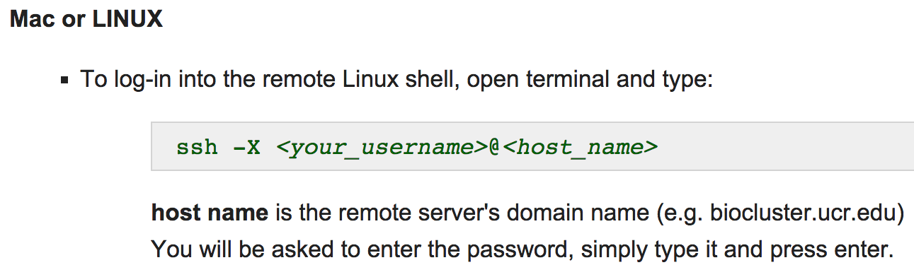
Logging-In
Format you will use:
ssh x500@login.msi.umn.edu
Notes:
ssh stands for secure shell
For the purposes of this tutorial we will only work from Macs, if you have questions on logging in to MSI from a Windows machine, see me after class.

Slide 4
Why GNU/Linux?
Software costs $0
Advanced Multitasking
Remote tasking (“real networking”)
Multiuser
Easy access to programming languages, databases, open-source projects
Software freedoms
Free to use for any purpose
Free to study and modify the source code
Free to share
Free to share modified versions
No dependence on vendors
Better performance
More up-to-date
Many more reasons…

Slide 5
Basics
Remember the UNIX/LINUX command line is case sensitive!
All commands in this manual are printed in gray code boxes.
Commands given in red are considered more important for beginners than commands given in black.
The hash (pound) sign “#” indicates the start of comments for commands.
The notation <…> refers to variables and file names that need to be specified by the user. The symbols < and > need to be excluded.
Notes:
Things to keep in mind when going through Thomas Girke’s tutorial

Slide 6
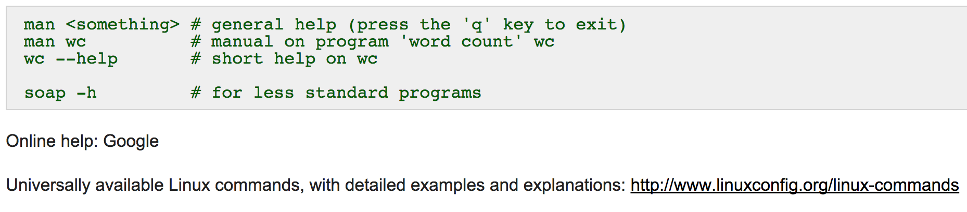
Unix Help
Notes:
Lifejacket analogy

Slide 7
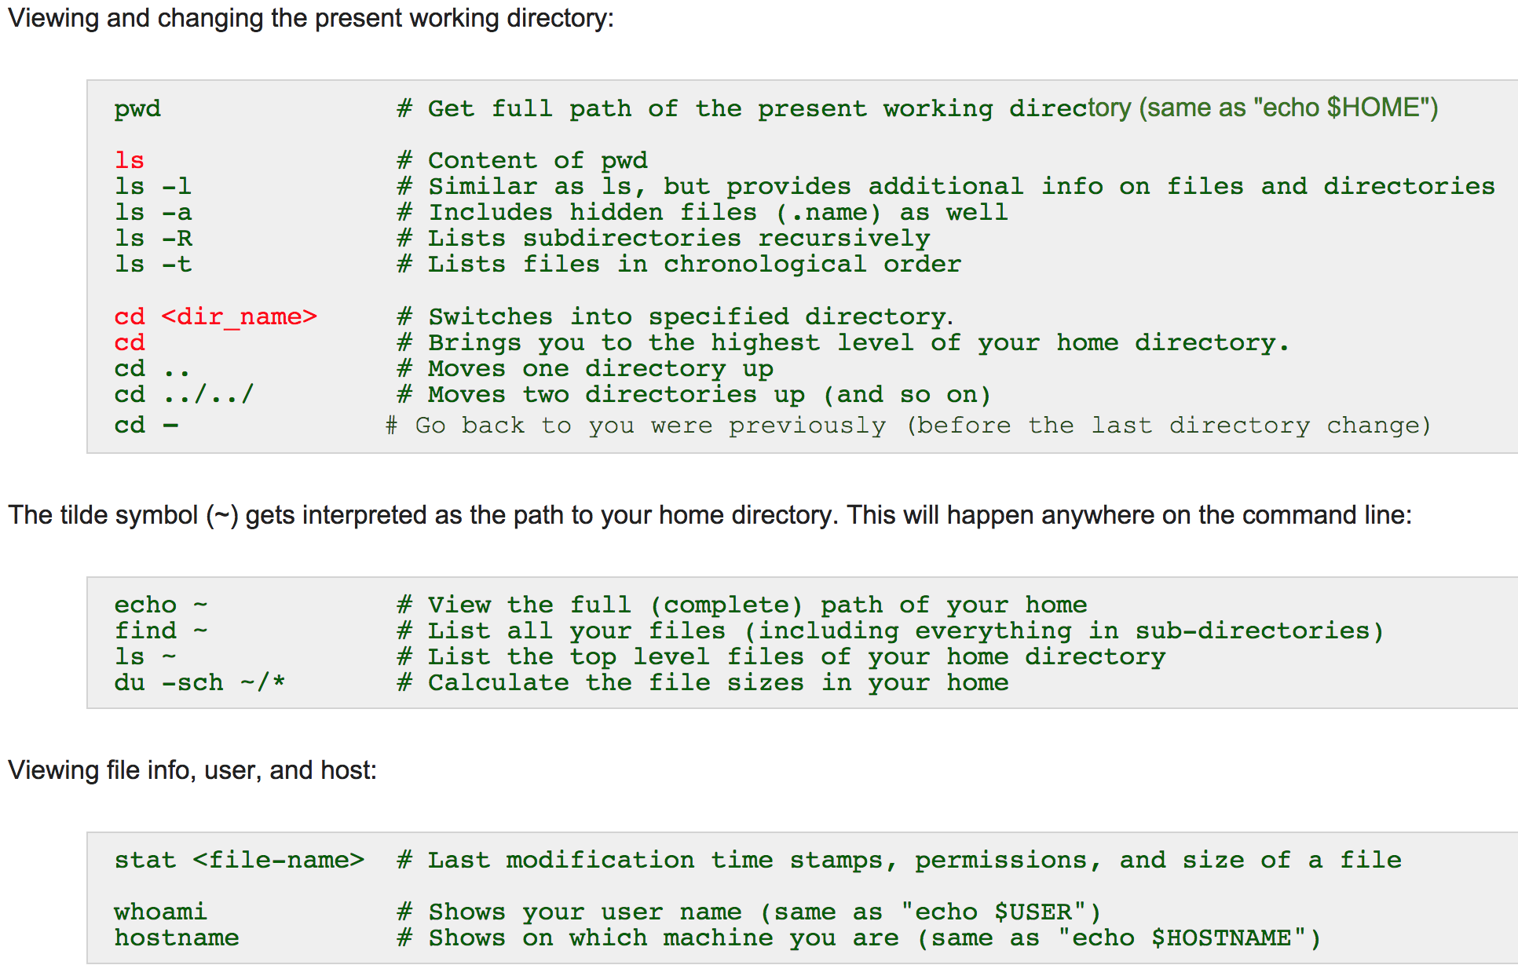
Orientation
Notes:
Have them type pwd in their terminals

Slide 8
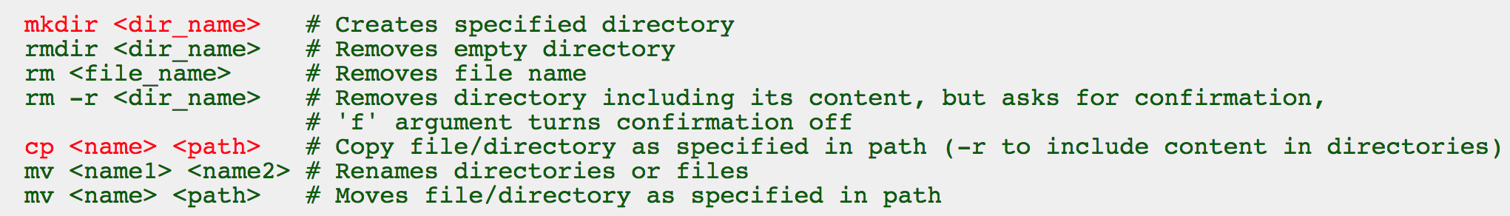
Exercise 1.1: Files and Directories
# Make directory called ‘GitHub’
# Use ‘mkdir’ command
mkdir GitHub
# Go into 'GitHub' directory with 'cd' command
cd GitHub
# Make another test directory called ‘test’ within ‘GitHub’ directory
mkdir test
# Now we will remove the directory called ‘test’ with ‘rm’ command
rm –rf test/
Notes:
Mention I have an answer key linked at the end of the slides

Slide 9
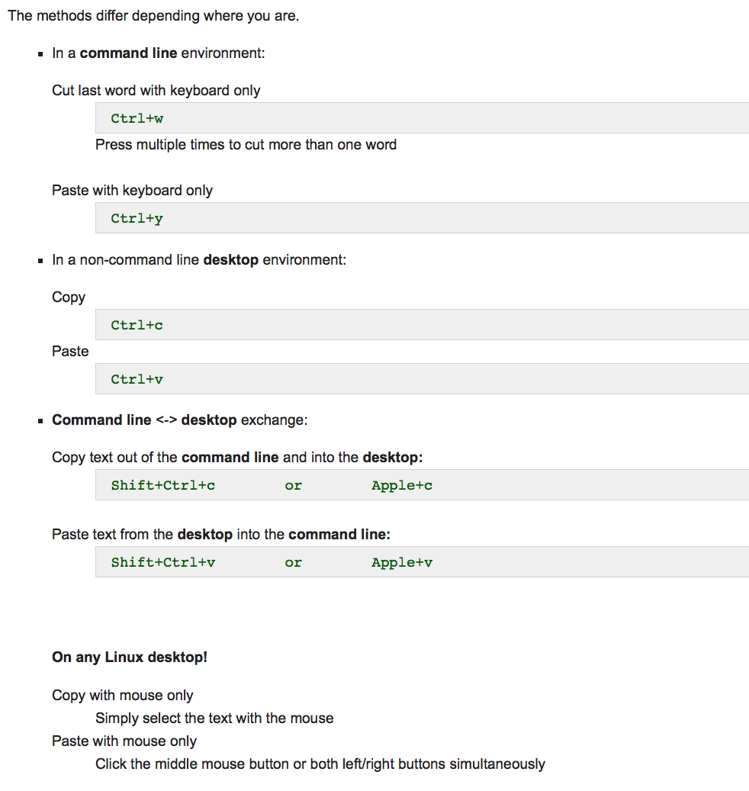
Copy and paste
Notes:
Maybe take out this slide

Slide 10
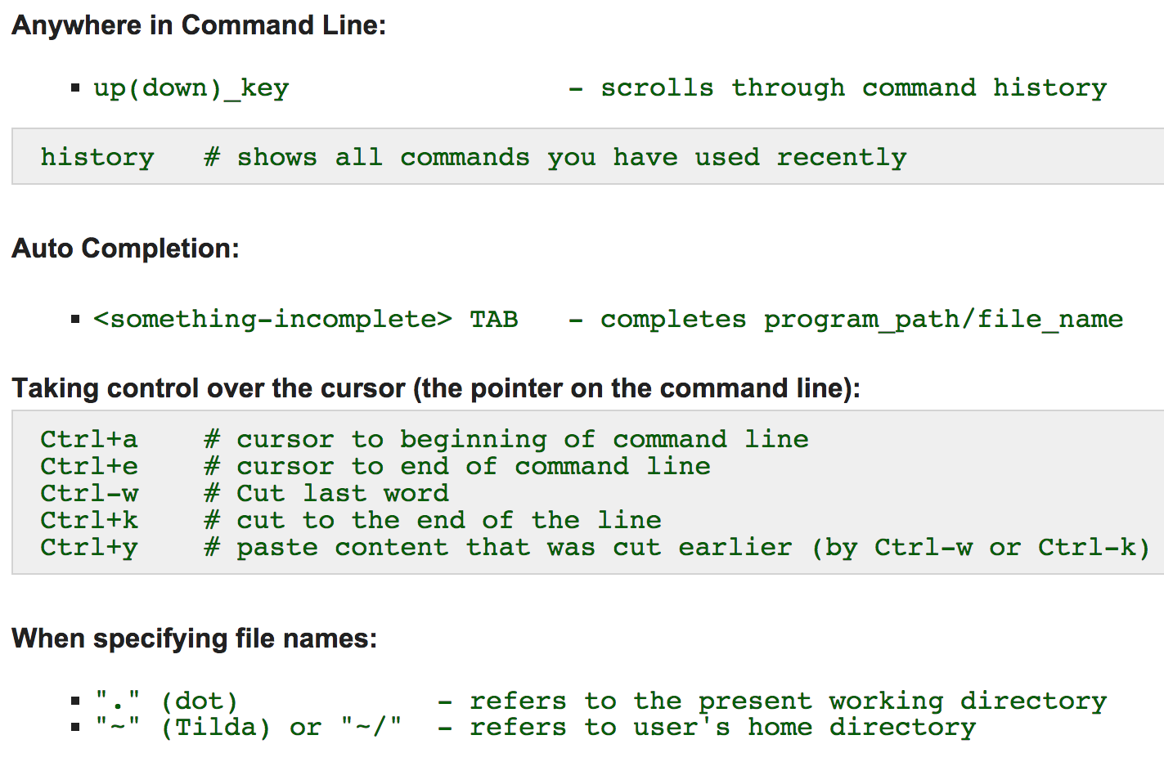
Handy Shortcuts
Notes:
Show them ‘pwd’ in home directory

Slide 11
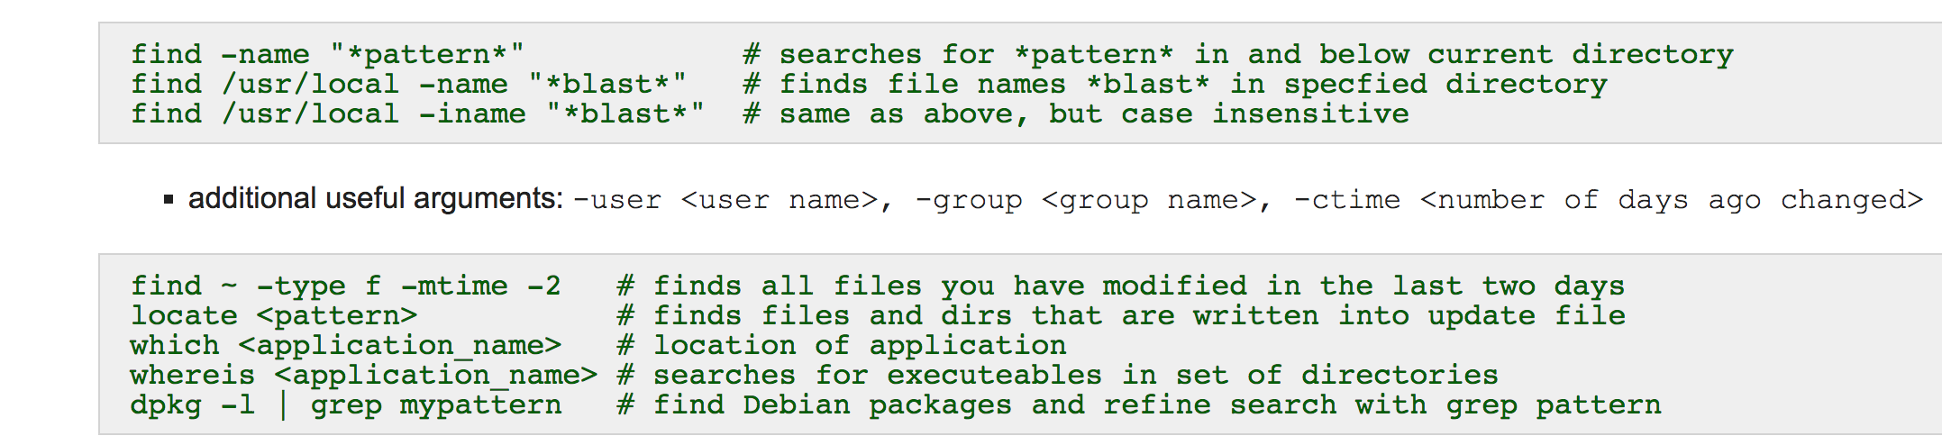
Finding Files in Directories and Applications
# Example of a find command we will be using frequently later on today
find `pwd` -name “filename” | sort

Slide 12
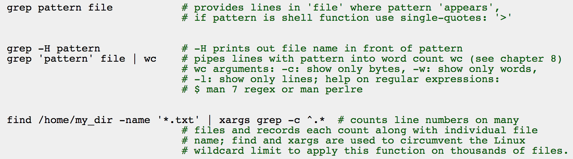
Finding Things in Files

Slide 13
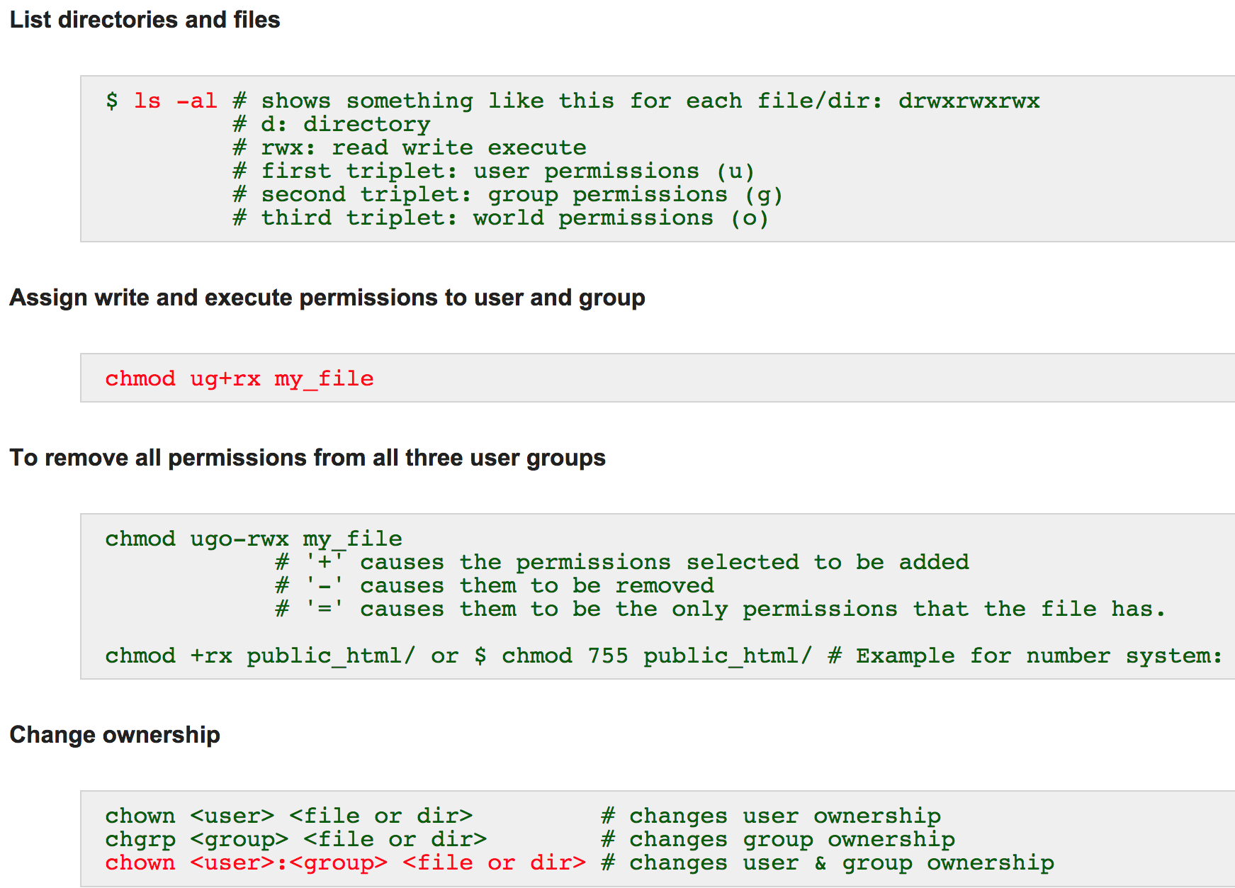
Permissions and Ownership

Slide 14
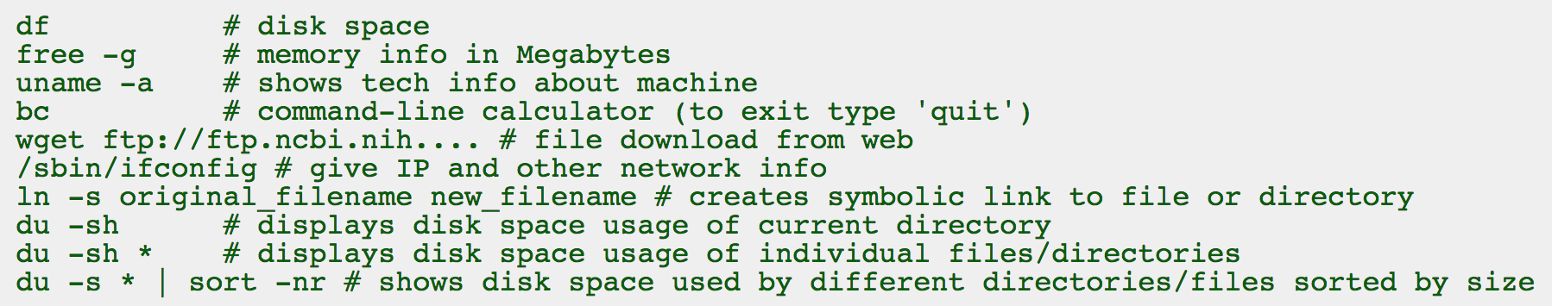
Exercise 1.2: Useful Unix Commands
# You should already be in the directory ‘GitHub’ we created earlier
# If not use ‘cd’ to get to the directory
cd ~/GitHub
# To download files to ‘GitHub’ directory, you must have the url of the raw format of the file
# Use the command ‘wget’
# You can download files by copying and pasting one url at a time
wget https://raw.githubusercontent.com/vsbuffalo/bds-files/master/chapter-07-unix-data-tools/contam.fastq

Slide 15
Exercise 1.2: Useful Unix Commands
# We will download another file from a different url
wget https://raw.githubusercontent.com/vsbuffalo/bds-files/master/chapter-07-unix-data-tools/contaminated.fastq
# Now let’s download multiple files from different links with ‘wget’
# Each link must be separated by a space
wget https://raw.githubusercontent.com/vsbuffalo/bds-files/master/chapter-03-remedial-unix/tb1-protein.fasta https://raw.githubusercontent.com/vsbuffalo/bds-files/master/chapter-03-remedial-unix/tb1.fasta https://raw.githubusercontent.com/vsbuffalo/bds-files/master/chapter-03-remedial-unix/tga1-protein.fasta

Slide 16
Exercise 1.2: Useful Unix Commands
# To view file sizes, permissions, date, etc. line by line
# Use the 'ls' command
# '-l' means use long listing format
# '-h' will print sizes of files in human readable format
ls -lh

Slide 17
STDIN, STDOUT, and STDERR
# By default, UNIX commands read from standard input (STDIN) and send their output to standard out (STDOUT)
# Example: STDIN and STDOUT
# This will take the input of a program and output it to be written to a file
ls –l
ls –l > ls-l.txt
# STDERR are error messages that output to the screen
# this is an example of grep errors output to the screen
grep da * 2
For more examples, see LINUX HOWTOs

Slide 18
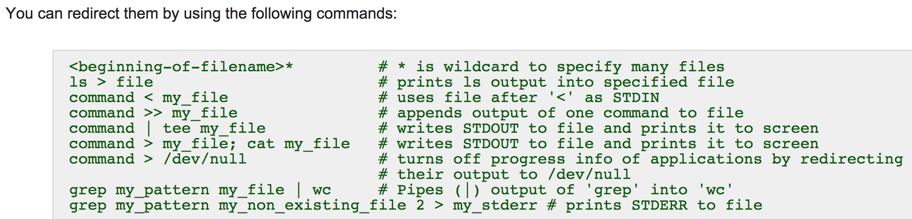
Redirections

Slide 19
Piping
Another form of redirects
A way to chain commands together
Can take STDOUT of one command and send it to STDIN of another
Denoted by the ‘|’ symbol
Example
find `pwd` -name “name_of _file” | sort

Slide 20
Globbing
Denoted by ‘*’ and is a wildcard
Find all that matches surrounding text
For example:
# Matches all files that end with a .fastq
*.fastq
# matches all files that start with WBDC_
WBDC_*
# matches all files that have the following date in the file name
*_2015-08-05*

Slide 21
Exercise 1.3: Using find, chmod and grep commands
# In the directory ~/GitHub
# Use ‘find’ command to locate all .fasta files
# 'pwd' means point working directory
# 'sort' sorts text line by line in alphabetical order
find `pwd` -name "*.fasta" | sort
# Check how many files are listed using ‘wc’ command
# ‘-l’ option searches line by line
find `pwd` -name "*.fasta" | sort | wc -l
# There should be 3 files with .fasta in their name

Slide 22
Exercise 1.3: Using find, chmod and grep commands
# In the directory ~/GitHub
# Use find command to locate all .fasta and .fastq files
find `pwd` -name "*.fast*" | sort
# Check how many files it found using 'wc' command
find `pwd` -name "*.fast*" | sort | wc –l
# There should be 5 files with either .fasta or .fastq in their filenames in ~/GitHub

Slide 23
Exercise 1.3: Using find, chmod and grep commands
# Use ‘ls’ command to view permissions of files downloaded
ls –l
# Now we will change permissions for the file ‘contam.fastq’
# Let’s assign read + write permissions for the user (u) and group (g)
# You almost never want to assign permissions to world (o) or other (o)
# World or other permissions gives anyone either read (r), write (w) and/or execute (x) permissions to your files
chmod ug+rx contam.fastq
# Use 'ls' command again to view change in permissions
ls -l

Slide 24
Exercise 1.3: Using find, chmod and grep commands
# We will now practice using ‘grep’ command
# We will need to download the file we are using to ~/GitHub
wget https://raw.githubusercontent.com/vsbuffalo/bds-files/master/chapter-07-unix-data-tools/lengths.txt
# Use ‘head’ to view the beginning of the file ‘lengths.txt’
head lengths.txt
# Use 'grep' command to pull all chr1 lengths
# specify what you are grepping for (i.e. chr1) and which file (i.e. lengths.txt) you are pulling from
grep chr1 lengths.txt

Slide 25
Exercise 1.3: Using find, chmod and grep commands
# Now redirect and create a new file called ‘chr1_lengths.txt’
grep chr1 lengths.txt > chr1_lengths.txt
# Use 'head' command to check file contents
head chr1_lengths.txt
Notes:
Note: creating filenames, make sure to not use spaces!!

Slide 26
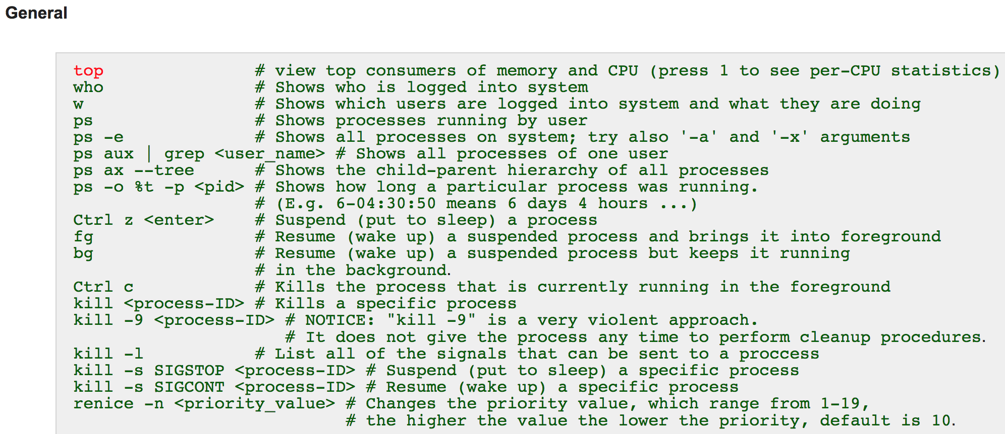
Process Management

Slide 27
Non-Graphical Text Editors
Vi and Vim
Non-graphical (terminal-based) editor
Vi is guaranteed to be available on any system
Vim is the improved version of vi
Pico
Simple terminal-based editor available on most version of Unix
Uses keystroke commands but they are listed in logical fashion at bottom of screen
Nano
A simple terminal-based editor which is default on modern Debian systems
Notes:
Debian system: free operating system, a UNIX like operating system, Linux distribution was based off of it

Slide 28
More Non-Graphical Text Editors
Emacs
Non-graphical or window-based editor
You still need to know keystroke commands to use it
Installed on all Linux distributions and on most other Unix systems
Xemacs
More sophisticated version of emacs, but usually not installed by default
All common commands are available from menus
Very powerful editor with:
Built-in syntax checking
Web-browsing
News-reading
Manual-page browsing
And more…

Slide 29
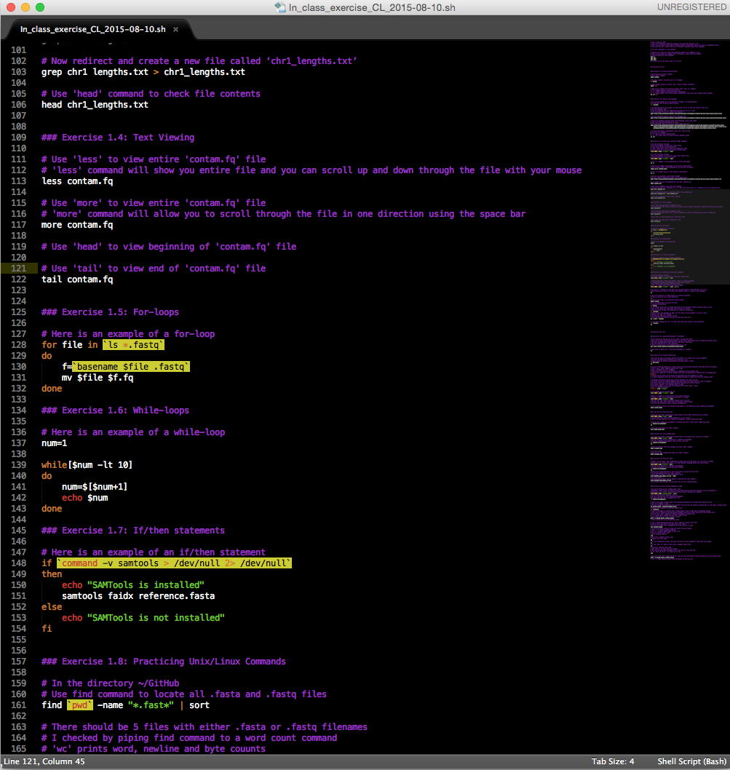
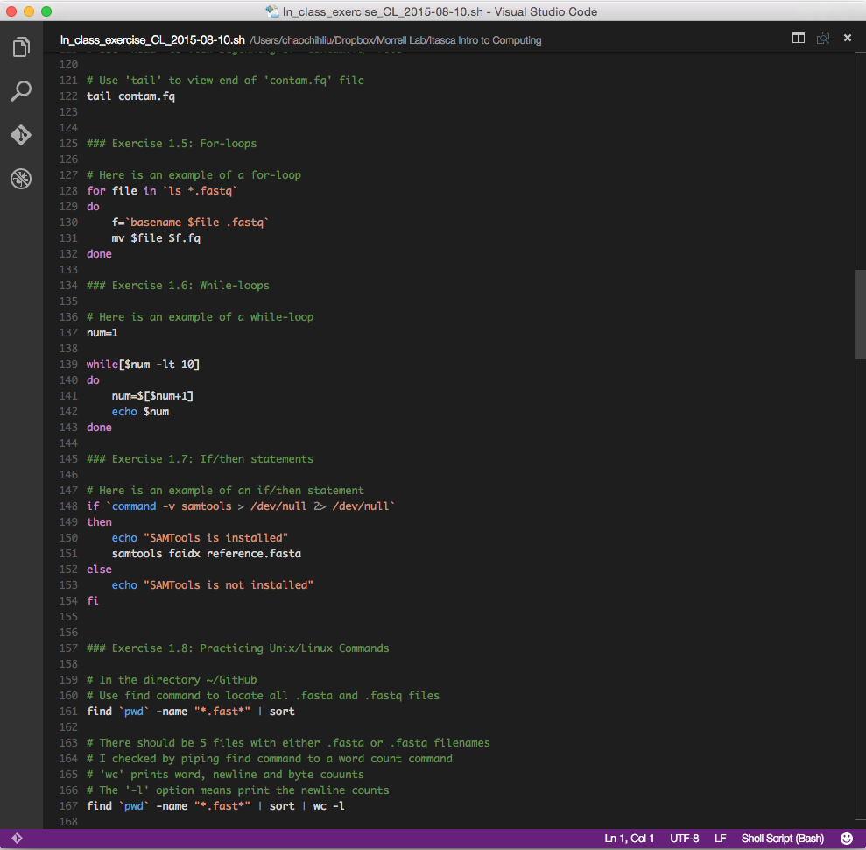
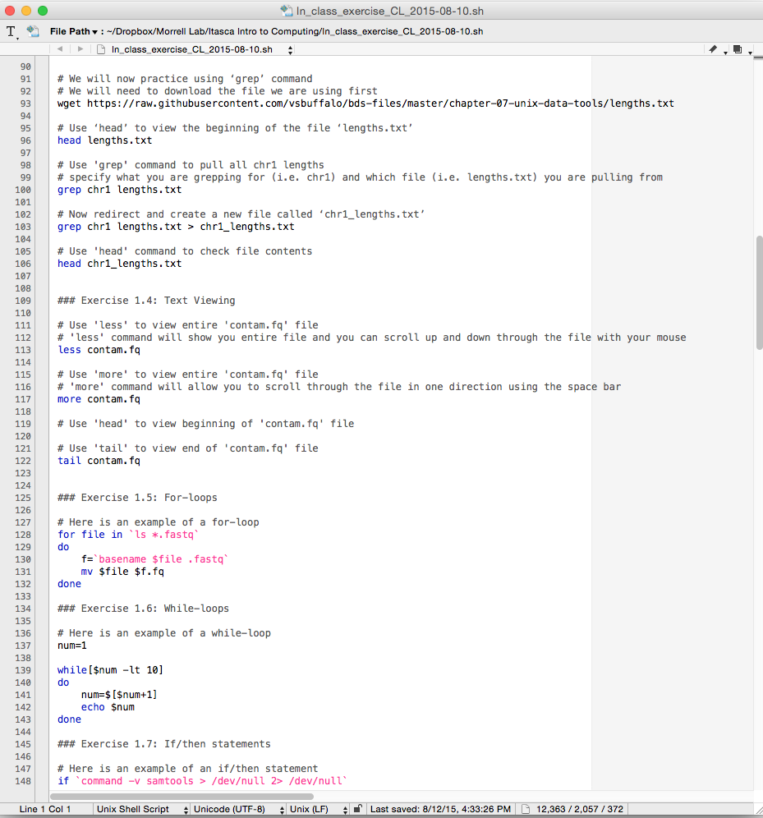
Graphical Text Editors
Sublime2
Graphical editor
Customizable
Cross Platform
OS X, Windows, Linux
Free unlimited trial period
Can also purchase license
Visual Studio Code
Graphical editor
Cross Platform
OS X, Windows, Linux
Free
Text Wrangler
Graphical editor
Macs only
Free
Many more…

Slide 30
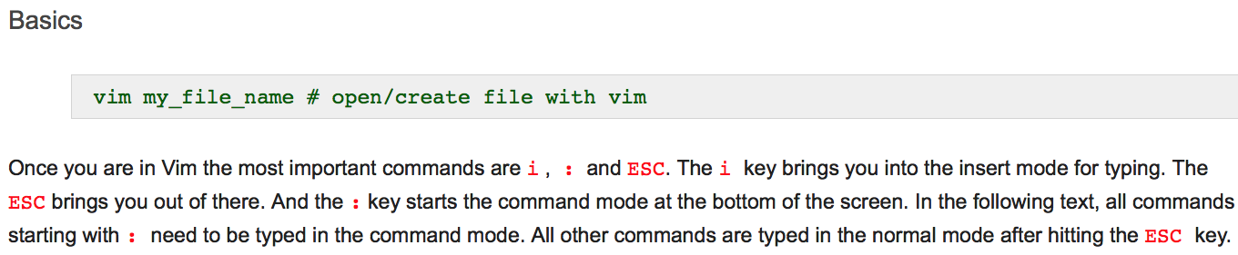
Vim Manual
Notes:
My go-to text editor

Slide 31
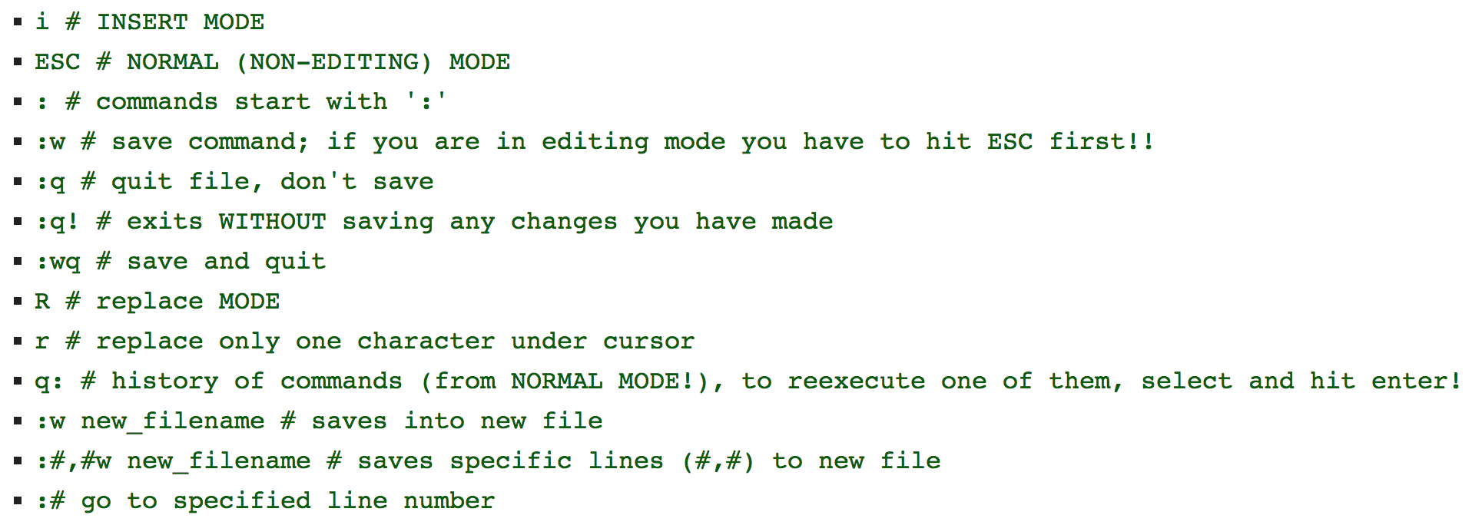
Modifier Keys to Control Vim

Slide 32
Additional Vim Commands
:s/txt1/txt2 # replace ‘txt1’ with ‘txt2’ on the current line
:%s/txt1/txt2 # replace ‘txt1’ with ‘txt2’ in the whole file
u # undo last change
<CTRL>+r # redo last undo
dd # delete current line
$ # go to end of current line
^ # go to beginning of current line
/txt # find all instances of ‘txt’ in file
<shift>+g # jump to the bottom of the page
gg # jump to the top of the page
Notes:
Prep a longer script for this example and put in itasca directory

Slide 33
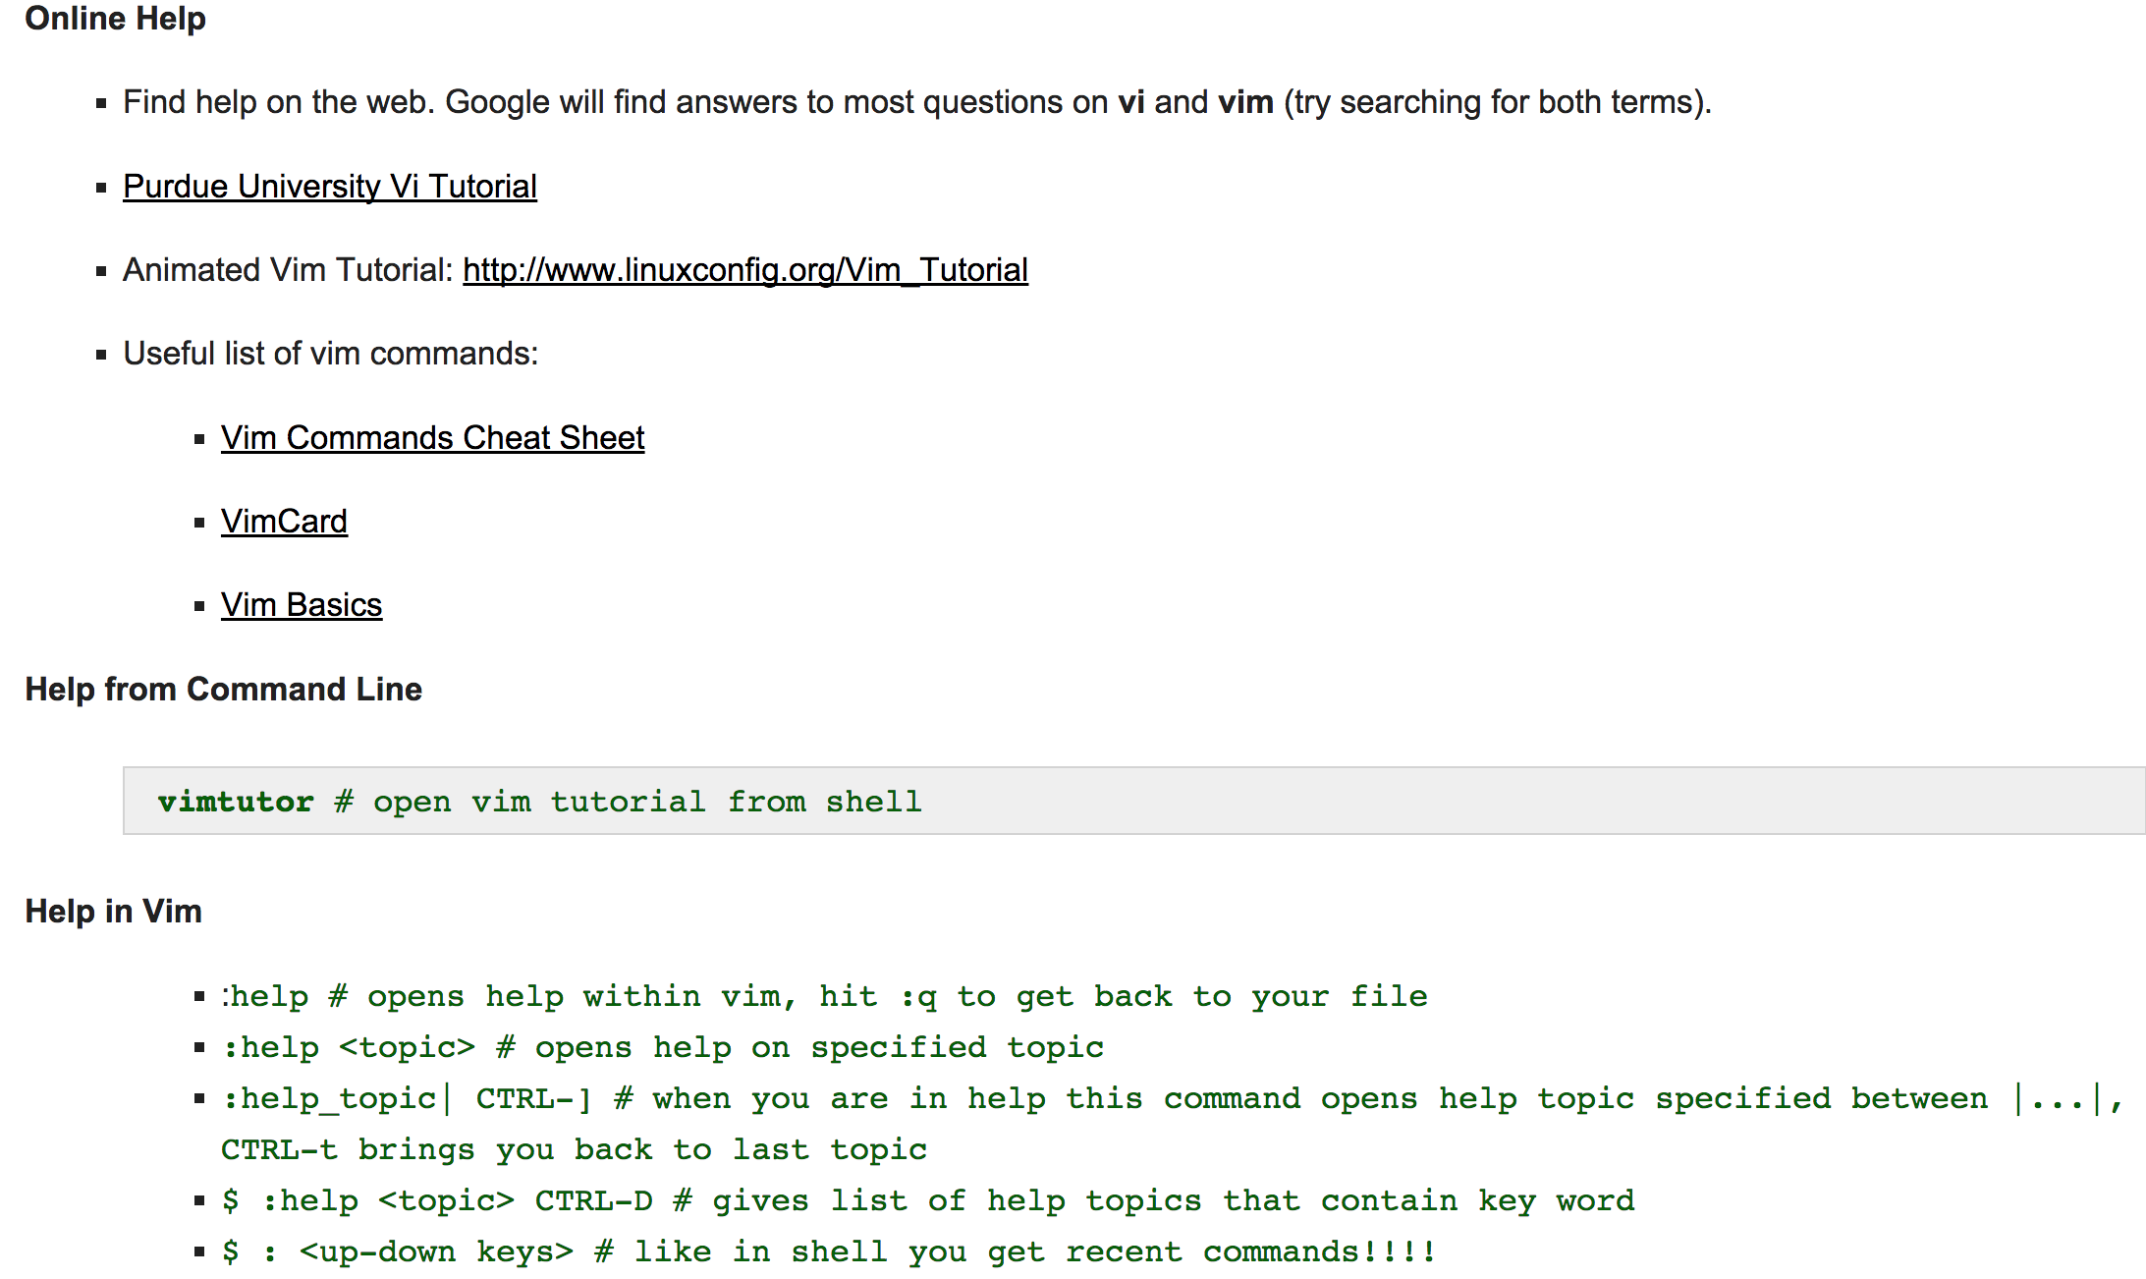
Vim Help
Notes:
For more on Vim reference Thomas Girke Tutorial, link included at the end of the slides

Slide 34
More Vim
Moving around in files
Line Wrapping and line numbers
Spell checking & dictionary
Enabling syntax highlighting
Deleting things
Search in files
Replacements with regular expression support
Printing and inserting files
Convert text file to HTML format
Shell commands in vim
Use Vim as Table Editor
To learn more about vim, reference the Thomas Girke tutorial (link provided at end of slides)

Slide 35
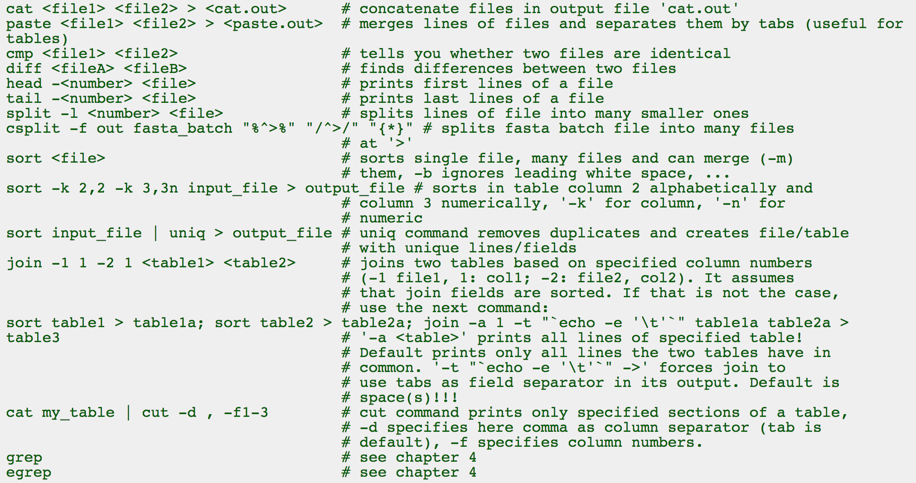
Useful Shell Commands

Slide 36
Exercise 1.4: Text Viewing
# Use 'less' to view entire 'contam.fastq' file
# 'less' command will show you entire file and you can scroll up and down through the file with your mouse
# Hit 'q' on keyboard to exit out of less
less contam.fastq
# Use 'more' to view entire 'contam.fastq' file
# 'more' command will allow you to scroll through the file in one direction using the space bar
more contam.fastq
Notes:
For more – show them RTC_Targets.intervals

Slide 37
Exercise 1.4: Text Viewing
# Use ‘cat’ to concatenate file and print ‘contam.fastq’ file content to standard output
cat contam.fastq
# Use 'head' to view beginning of 'contam.fastq' file
head contam.fastq
# Use 'tail' to view end of 'contam.fastq' file
tail contam.fastq

Slide 38
Other Important Commands
Alt+left arrow # jump one word back
Alt+right arrow # jump one word forward
Ctrl+a # jump to the beginning of the line
Ctrl+e # jump to the end of the line
Ctrl+c # terminate current running programs
exit or Ctrl+d # exit out of your shell

Slide 39
Loops
A way of executing a command or a series of commands on multiple cases multiple times
Saves time
Iterations over a range of data
Running a command endlessly to monitor the status of a job
Performing an operation on hundreds of files
Reduce chance of human error
Let the computer take care of all steps
Fast
Takes considerably less time than running commands manually

Slide 40
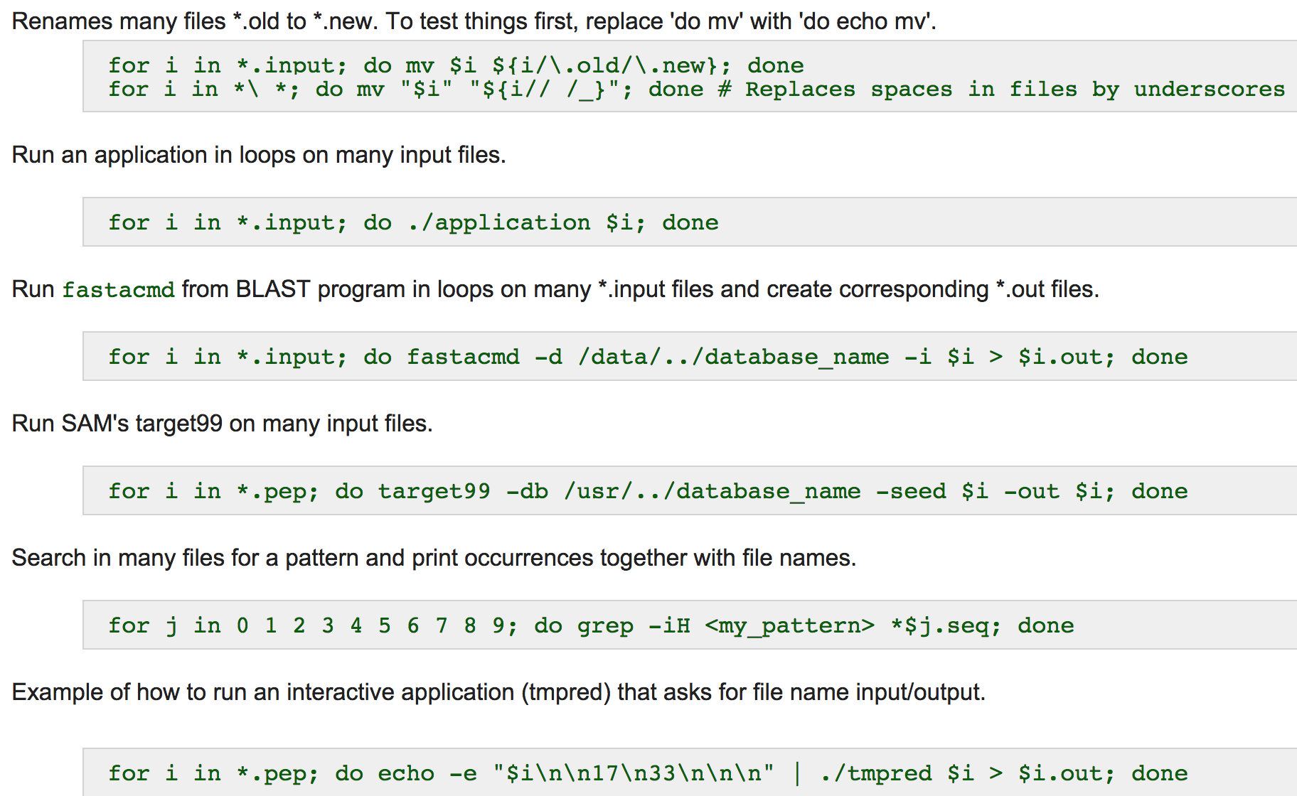
Examples on for-loops
Notes:
Decide if I want to go through this

Slide 41
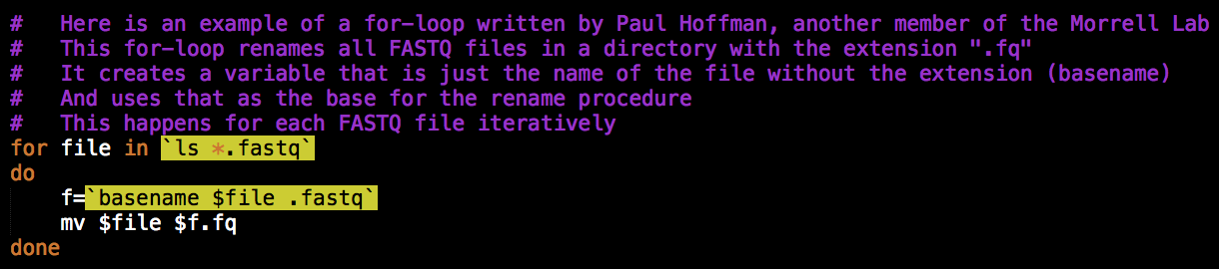
Exercise 1.5: For-loops
A class of loop structures
Used for iterations through data/files to perform the same operation multiple times on a set
Check the directory contents with ‘ls’ and you should see all the files that originally had ‘.fastq’ in the filename change to ‘.fq’
Notes:
What for-loops are/concept of looping

Slide 42
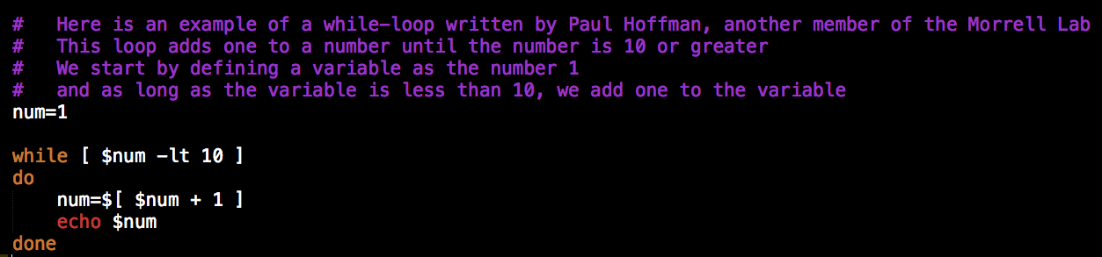
Exercise 1.6: While-loops
Another class of loop structures
Used for:
Conditional (i.e. yes/no, true/false statements) looping
Running a command given something that is either true or false

Slide 43
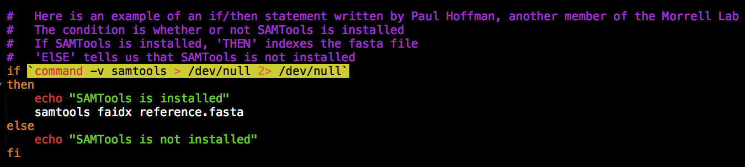
If/then Statements
Different lines of code can be executed depending on whether or not something tests true or not

Slide 44
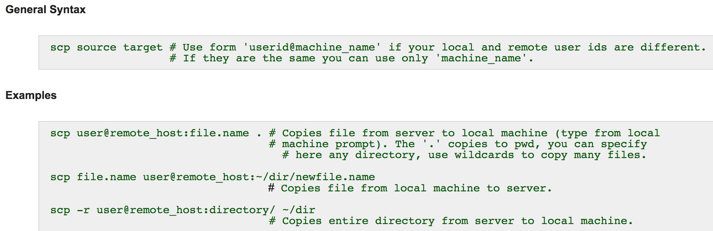
Secure Copy Between Machines

Slide 45
Archives
Single package containing multiple files within themselves
Makes distributing packs of files easy
For example, distributing software
Many kinds that are often called packages
Most common is tarball

Slide 46
Tarballs
A form of archives
Created by tar utility
Easy to create and nearly universal
Standard file format: .tar
Compressed file formats:
Gzip: .tgz
Bzip2: .tbz

Slide 47
Compressed Files
Take up less space
These files are unviewable while compressed
Different commands are used to decompress/compress different compression formats
3 different compressions utilities used: gzip, zip and bzip2
Common Compression Formats
.gz
.tgz
.tar.gz
.zip
.tar.zip
.bz2
.tar.bz2
.tbz
.tbz2
Notes:
Gzip, bzip2, zip

Slide 48
How to Decompress Files
Decompress gzipped files:
Use ‘gzip –d’ to decompress gzipped files
Use ‘tar –xvzf’ to decompress gziped tarball
Decompress bzip2 files:
Use ‘bzip2 -d’ to decompress bzip2 files
Use ‘tar –xvjf’ to decompress bzipped tarball
Decompress zipped files:
Use ‘unzip’ to decompress zipped files
Use ‘unzip’ then ‘tar –xvf’ to decompress a zipped tarball
Notes:
Show example of viewing unzipped file

Slide 49
Command Substitutions
Process of using the output of one command as the argument for another
Example
find `pwd` -name “*.sam”
‘pwd’ command outputs full path to the current working directory (path to working directory)
‘find’ command looks through pwd for filename(s) specified with double quotes
Notes:
Skip if necessary

Slide 50
PATH
List of directories that the shell will search when you type a command
Where software is installed
echo $PATH # view the PATH variable
export PATH=$PATH:<path to directory> # You can edit PATH variable
# Edit is not permanent
# unless you put it in
# your .bash_profile

Slide 51
Exercise 1.8: Practicing Unix/Linux Commands
# In the directory ~/GitHub
# Use find command to locate all .fasta and .fq files
find `pwd` -name "*.f*" | sort
# There should be 3 files with either .fasta or .fq filenames
# I checked by piping find command to a word count command
# 'wc' prints word, newline and byte counts
# The '-l' option means print the newline counts
find `pwd` -name "*.fast*" | sort | wc -l
Notes:
Check this slide again

Slide 52
Exercise 1.8: Practicing Unix/Linux Commands
# Now use 'ls' command to view the files you downloaded to the directory you are in
# You should see a total of 3 files with .fasta in the filename
ls
# Now let's move all of these files to a project directory
# First we will go to our home directory
cd
# Then we will make a new directory called Itasca
mkdir Itasca

Slide 53
Exercise 1.8: Practicing Unix/Linux Commands
# 'ls' to check your directory is there
# Go into the directory
cd Itasca
# 'ls' again if you want to check the files in the directory (There should be none so far)
# Now we will move the .fasta and .fq files to ~/Itasca
# First we will go into the directory our files are located in
cd ~/GitHub

Slide 54
Exercise 1.8: Practicing Unix/Linux Commands
# Then we will use globbing to move all the files at once instead of one at a time
# We will use the 'mv' command
# Followed by the files we want to move
# Then specify the directory we want to move the files into
mv *.f* ~/Itasca
# 'cd' into ~/Itasca and 'ls' to check that files were moved to that directory

Slide 55
Resources
Thomas Girke’s Linux tutorial:
http://manuals.bioinformatics.ucr.edu/home/linux-basics
Answer key to today’s exercises can be viewed and downloaded from my Gist repository:
https://gist.github.com/liux1299/af6fffc5d96e8d44dc9b

